Slide 1
Networking

Slide 2
What is Computer Networking?
A computer network is a system that connects numerous independent computers in order to share information (data) and resources. The integration of computers and other different devices allows users to communicate more easily.
A network connection can be established using either cable or wireless media. Hardware and software are used to connect computers and tools in any network.
A computer network consists of various kinds of nodes. Servers, networking hardware, personal computers, and other specialized or general-purpose hosts can all be nodes in a computer network. Host names and network addresses are used to identify them.

Slide 3
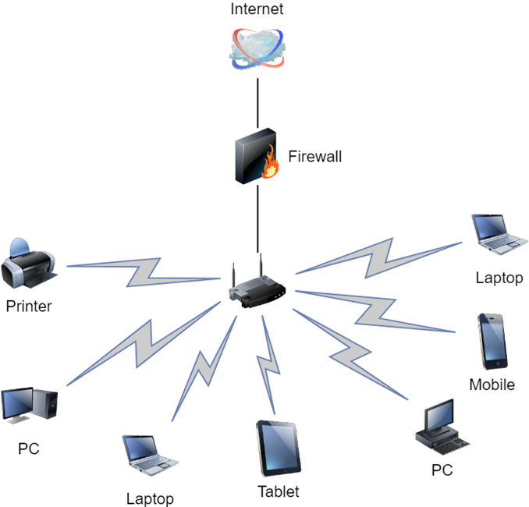

Slide 4
IP Addresses
An IP address is a unique address that identifies a device on the internet or a local network. IP stands for "Internet Protocol," which is the set of rules governing the format of data sent via the internet or local network.
The internet needs a way to differentiate between different computers, routers, and websites. IP addresses provide a way of doing so and form an essential part of how the internet works.
IP addresses are expressed as a set of four numbers — an example address might be 192.158.1.38. Each number in the set can range from 0 to 255. So, the full IP addressing range goes from 0.0.0.0 to 255.255.255.255.
IP addresses are not random. They are mathematically produced and allocated by the Internet Assigned Numbers Authority (IANA)
All devices find, send, and exchange information with other connected devices using this protocol. By speaking the same language, any computer in any location can talk to one another.

Slide 5

What is IPv4?
IPv4 is a version 4 of IP. It is a current version and the most commonly used IP address. It is a 32-bit address written in four numbers separated by 'dot', i.e., periods. This address is unique for each device. For example, 66.94.29.13
Each group of numbers separated by periods is called an Octet. Each number in an octet is in the range from 0-255.
In today's computer network world, computers do not understand the IP addresses in the standard numeric format as the computers understand the numbers in binary form only. The binary number can be either 1 or 0. The IPv4 consists of four sets, and these sets represent the octet. The bits in each octet represent a number.
Each bit in an octet can be either 1 or 0. If the bit the 1, then the number it represents will count, and if the bit is 0, then the number it represents does not count.
The above representation shows the structure of 8- bit octet.

Slide 6
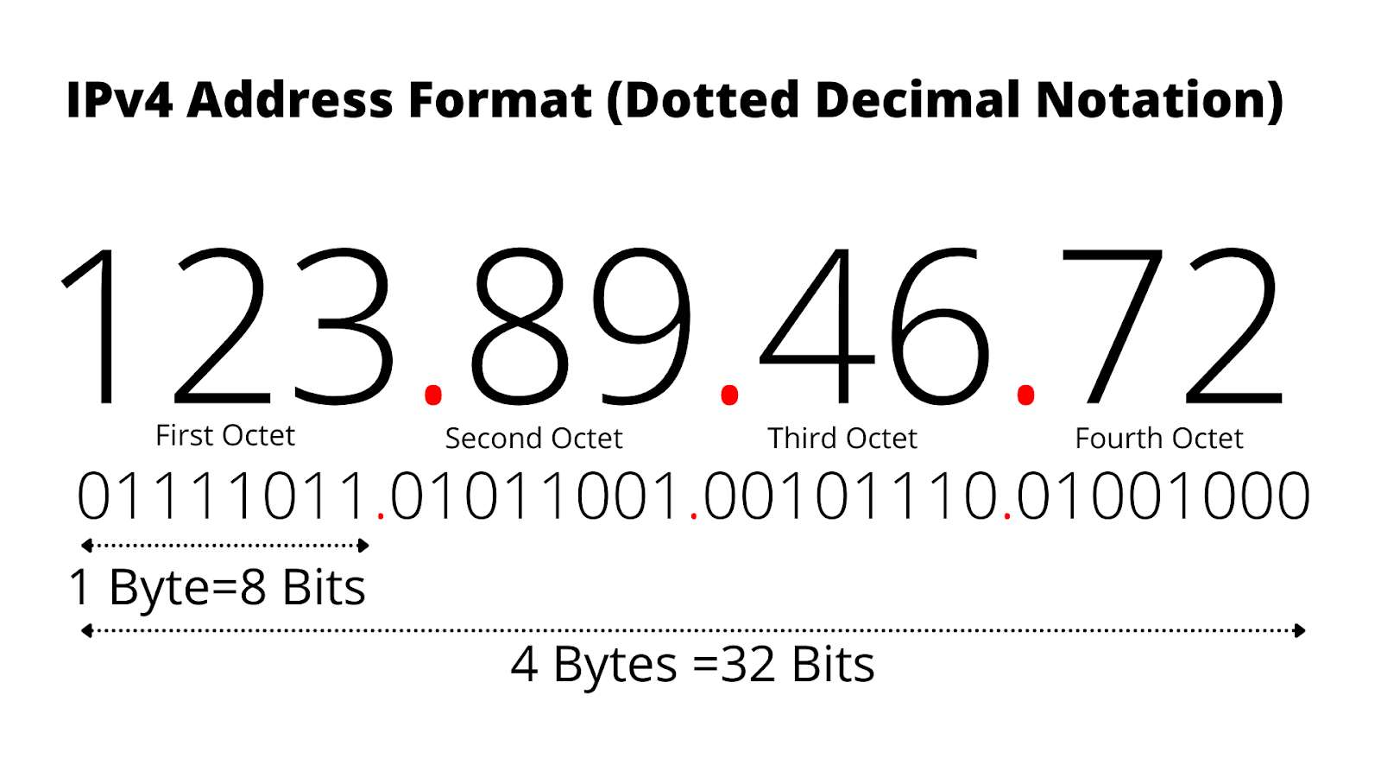
Now, we will see how to obtain the binary representation of the IP address

Slide 7
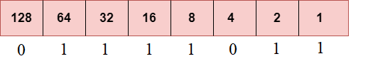
To obtain 123, we put 1 under 64, 32, 16, 8, 2 and 1 as the sum of these numbers is equal to 123, and the remaining bits will be zero. Therefore, the binary bit version of 123 is 01111011
To get a binary representation of all other numbers such as 89, 46 and 72 we apply the same logic for each of them

Slide 8
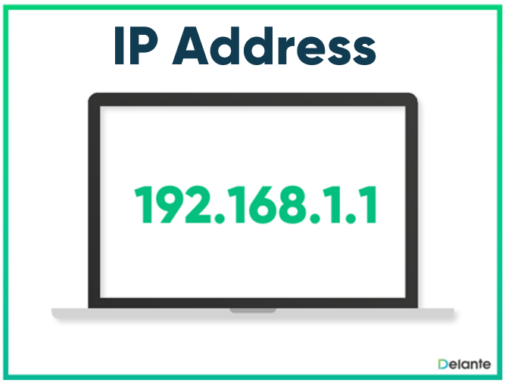
Drawback of IPv4
Currently, the population of the world is 7.6 billion. Every user is having more than one device connected with the internet, and private companies also rely on the internet. As we know that IPv4 produces 4 billion addresses, which are not enough for each device connected to the internet on a planet.
So it gave rise to the development of the next generation of IP addresses, i.e., IPv6.

Slide 9

What is IPv6?
IPv4 produces 4 billion addresses, and the developers think that these addresses are enough, but they were wrong. IPv6 is the next generation of IP addresses. The main difference between IPv4 and IPv6 is the address size of IP addresses. The IPv4 is a 32-bit address, whereas IPv6 is a 128-bit hexadecimal address. IPv6 provides a large address space, and it contains a simple header as compared to IPv4.
This hexadecimal address contains both numbers and alphabets. Due to the usage of both the numbers and alphabets, IPv6 is capable of producing over 340 undecillion (3.4*10³⁸) addresses.
IPv6 is a 128-bit hexadecimal address made up of 8 sets of 16 bits each, and these 8 sets are separated by a colon. In IPv6, each hexadecimal character represents 4 bits. So, we need to convert 4 bits to a hexadecimal number at a time

Slide 10
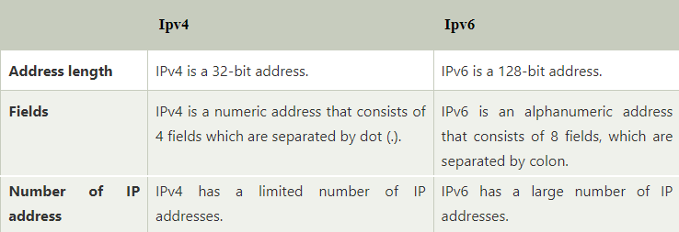
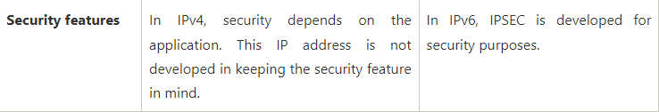
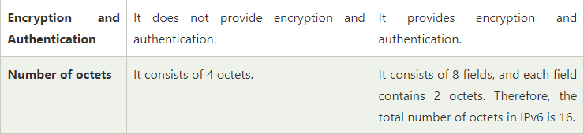

Slide 11

What are subnets and subnet masks in computer networks?
Subnet Mask is used in networking to create multiple sub networks in a network. It divides the IP address into multiple parts which can be assigned to every computer. Subnet Mask is made by setting the network bits to all "1"s and setting host bits to all "0"s. Within a given network, two host addresses are reserved for a special purpose, and cannot be assigned to hosts.
The binary "0" in the subnet mask tell us about the host address. It tells us about the IP of the host which has done subnetting.
Suppose we have a subnet address as 192.168.1.0. In this, all host addresses are zero. It will be represented in binary as
In this way, we set the host bits to zero in the Subnet mask.

Slide 12
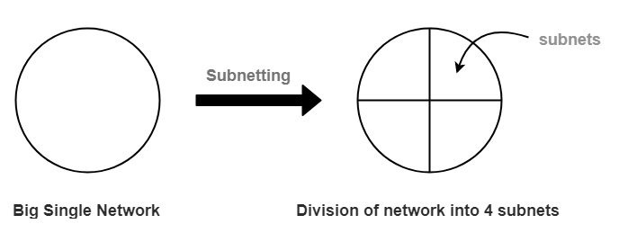

Slide 13
Every website needs a unique IP address, in order to uniquely identify the website, we are dividing the IP network into two or more networks called subnet, which is preferred to control network traffic.
It is a smaller network inside a large network. This technique makes the network routing an efficient one.
The main features of subnet are as follows :
Reduce network congestion.
Control network growth
Ease administration
Boost network security

